Slide 1
IFT222
Computer Architecture and Organization I
MODULE5: PROCESSOR TYPES – RISC VERSUS CISC

Slide 2
Learning Outcomes
At the end of this lesson, students should be able to:
Define Instruction Set Architecture (ISA).
Explain the concepts of RISC and CISC architectures.
Describe the characteristics of RISC processors.
Describe the characteristics of CISC processors.
Compare RISC and CISC architectures based on design principles and performance.
Identify advantages and disadvantages of both architectures.
Analyze practical applications of RISC and CISC processors.
Differentiate between modern processor implementations of RISC and CISC.

Slide 3
Introduction
A processor is the logic circuitry that responds to and processes the basic instructions that drive a computer.
CPU instructions are numbers stored in memory.
Instruction set is a set of instructions a programmer can give to a machine to perform operations.
The instructions are specific to CPU architecture.
Basic operations: read instruction from memory, decode, execute ,write back.

Slide 4
Introduction
Over the years, two major processor design philosophies emerged:
Complex Instruction Set Computer (CISC)
Reduced Instruction Set Computer (RISC)
These architectures were developed to address different challenges in processor design and performance optimization.

Slide 5
Historical Background
During the 1960s and 1970s, memory was expensive while processor hardware was relatively cheap.
Engineers attempted to reduce program size by creating processors with powerful instructions capable of performing complex tasks in a single instruction.
This led to the development of CISC architectures.
By the early 1980s, researchers discovered that:
Most programs used only a small subset of available instructions.
Complex instructions often required multiple clock cycles.Simpler instructions could be executed much faster.This observation led to the development of RISC architectures.

Slide 6
Historical Background
During the 1960s and 1970s, memory was expensive while processor hardware was relatively cheap.
  Engineers attempted to reduce program size by creating processors with powerful instructions capable of performing complex tasks in a single instruction.
This led to the development of CISC architectures.
  By the early 1980s, researchers discovered that:
  Most programs used only a small subset of available instructions.
  Complex instructions often required multiple clock cycles.
  Simpler instructions could be executed much faster.
This observation led to the development of RISC architectures.

Slide 7
Question
Why were CISC architectures initially popular?

Slide 8
Answer
Because memory was expensive, and CISC instructions could perform complex operations using fewer instructions, thereby reducing program size.

Slide 9
CISC: Complex Instruction Set Computers
CISC existed close to the beginning of general computing.
Since the earliest machines were programmed in assembly language and memory was slow and expensive, IBM designed an instruction set to allow early programmer to easily program a hundred complex instruction rather than thousands of individual instructions.
CISC was developed to make compiler development simpler. It shifts most of the burden of generating machine instructions to the processor.
For example, instead of having to make a compiler write long machine instructions to calculate a square-root, a CISC processor would have a built-in ability to do this.

Slide 10
CISC Architecture
Complex instruction set computing is a CPU design where single instructions can execute several low-level operations (such as a load from memory, an arithmetic operation, and a memory store) or are capable of multi-step operations or addressing modes within single instructions.
Called “complex” because of the complex work performed per instruction.
Concept: Encode the intention directly.
Eg:” add X and Y and put the result in Z” (for X,Y,Z memory address)
Problem: Some instruction take more time then others.
Examples: x86, s390.
Small number of general purpose registers

Slide 11
cont….
• Computers typically use CISC while tablets, smartphones and other devices use RISC.
• So, the higher efficiency of the RISC architecture makes it desirable in these applications where cycles and power are usually in short supply.
• In CISC instructions are executed by microcode.
• A CISC instruction set typically includes many instructions with different sizes and execution cycles, which makes CISC instructions harder to pipeline.

Slide 12
Characteristic of CISC Processors
A CISC instruction can be thought to contain many different type of instructions bundled into one simple instruction.
A large number of instructions - typically from 100 to 250 instructions.
Some instructions that perform specialized tasks and are used infrequently.
A large variety of addressing modes - typically 5 to 20 different modes.
Variable-length instruction formats
Instructions that manipulate operands in memory.

Slide 13
Properties of a CISC Processor
Richer instruction set, some simple, some very complex.
2. Instructions generally take more than 1 clock to execute.
3. Instructions of a variable size.
4. Instructions is an interface with memory in multiple mechanisms with complex addressing modes.
5. No pipelining.
6. Microcode control make CISC instruction set possible & flexible.
7. Work well with simpler compiler.

Slide 14
Advantages
Microprogramming is as easy as assembly language to implement, and much less expensive than hardwiring a control unit.
As each instruction became more capable, fewer instructions could be used to implement a given task. This made more efficient use of the relatively slow main memory.
Because micro-program instruction sets can be written to match the constructs of high-level languages, the compiler does not have to be as complicated.

Slide 15
Disadvantages
Complex instructions are infrequently used by programmers and compilers.
Memory references, loads and stores, are slow and account for a significant fraction of all instructions.
Procedure and function calls are a major bottleneck, passing arguments, storing and retrieving values in registers.
Instruction set & chip of new generation hardware become more complex with each generation of computers.

Slide 16
CISC Instruction Example
A CISC could multiply 5 by 10 as follows:
Mov ax,10
Mov bx,5
Mul bx

Slide 17
RISC: Reduced Instruction Set Computer
History
The first RISC projects came from IBM, Stanford, and UC-Berkeley in the late 70s and early 80s.
The IBM 801, Stanford MIPS, and Berkeley RISC 1 and 2 were all designed with a similar philosophy which has become known as RISC.
When designers create a new generation of processors, improving performance is the key goal. There are three main factors that affect performance; they are :
  • How fast you can crank up the clock.
  • How much work you can do per cycle.
  • How many instructions you need to perform a task.

Slide 18
Philosophy of RISC
Instead of one complex instruction:
MULT A, B
RISC breaks the operation into simple instructions:
  LOAD R1, A
  LOAD R2, B
  MUL R3, R1, R2
  STORE R3, C
Although more instructions are required, each executes very quickly.

Slide 19
RISC Architecture
Called “reduced” because of the reduction of work performed by an instruction.
It is a type of microprocessor architecture that utilizes a small, highly-optimized set of instructions, rather than a more specialized set of instructions often found in other types of architectures.
RISC's original goals was to limit the number of instructions on the chip so that each could be allocated enough transistors to make it execute in one cycle.
Small set of instructions of a typical RISC processor consists mostly of register-to-register operations, with only simple load and store operations for memory access.

Slide 20
cont….
Thus each operand is brought into a processor register with a load instruction
• All computations are done among the data stored in processor registers.
• Results are transferred to memory by means of store instructions.
Concepts: Break operation into simpler sub operations.
Eg: instruction:
  load X,
  load Y,
  add X and Y,
  store Z

Slide 21
Characteristic of RISC Processors
• Simplifies the instruction set..
• The use of only a few addressing modes results from the fact that almost all instructions have simple register addressing.
• Other addressing modes may be included, such as immediate operands.
• By using a relatively simple instruction format, the instruction length can be fixed and aligned on word boundaries.
• An important aspect of RISC instruction format is that it is easy to decode.
• Shorter Instructions - Breaking the complex instruction into several short simpler instructions

Slide 22
cont….
• It has the ability to execute one instruction per clock cycle.
This is done by overlapping the fetch, decode and execute phases of two or three instructions by using a procedure referred to as pipelining.
• The advantage of register storage as opposed to memory storage is that registers can transfer information to other registers much faster than the transfer of information to and from memory.
• Relatively few instructions
• Relatively few addressing modes.
• Memory access limited to load and store instructions
• Can run several instructions simultaneously.

Slide 23
Properties of a RISC Processor
Simple primitive instructions and addressing modes.
2. Instructions execute in one clock cycle.
3. Uniformed length instructions and fixed instruction format.
4. Instructions interface with memory via fixed mechanisms(load/store).
5. Pipelining.
Hardwired control.
Complexity pushed to the compiler.

Slide 24
Advantages of RISC
Speed: RISC processors often achieve 2 to 4 times the performance of CISC processors using comparable semiconductor technology and the same clock rates.
Simpler hardware. Because the instruction set of a RISC processor is so simple, it uses up much less chip space and simple hardware requirements.
Shorter design cycle. Since RISC processors are simpler than corresponding CISC processors, they can be designed more quickly, and can complete there work in 1 clock cycle

Slide 25
Disadvantages of RISC
Code Quality: The performance of a RISC processor depends greatly on the code that it is executing. If the programmer (or compiler) does a poor job of instruction scheduling, the processor can spend quite a bit of time stalling (waiting for the result of one instruction before it can proceed with a subsequent instruction).
Code expansion: Since CISC machines perform complex actions with a single instruction, where RISC machines may require multiple instructions for the same action, code expansion can be a problem.
System Design: Another problem that faces RISC machines is that they require very fast memory systems to feed their instructions. RISC-based systems typically contain large memory caches, usually on the chip itself. This is known as a first-level cache.

Slide 26
RISC Instruction Example
In RISC the microprocessor's designers might make sure that add executes in one clock.
Then a compiler could multiply a and b by adding a to itself b times or b to itself a times.
Mov ax,0
  Mov bx,10
  Mov cx,5
  Begin:
  Add ax,bx
  Loop Begin
  loop cx times

Slide 27
RISC 5 Stage Pipelining
Fivestage “RISC” load-‐store architecture
1. Instruction fetch (IF)
• Get instruction from memory, increment PC.
2. Instruction Decode (ID)
• Translate opcode into control signals and read registers.
3. Execute (EX)
• Perform ALU operation, compute jump/branch target
4. Memory (MEM)
• Access memory if needed
5. Writeback (WB)
• Update register file

Slide 28
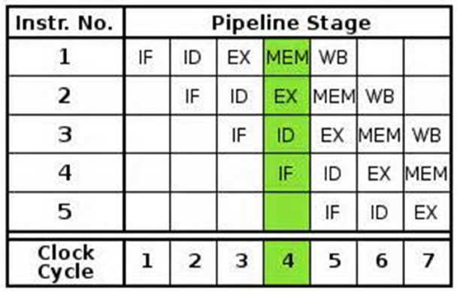
RISC 5 Stage Pipelining

Slide 29
Question
Why is pipelining more difficult in CISC processors?

Slide 30
Answer
Because instructions have varying lengths and execution times, making it harder to process instructions uniformly through the pipeline stages.

Slide 31
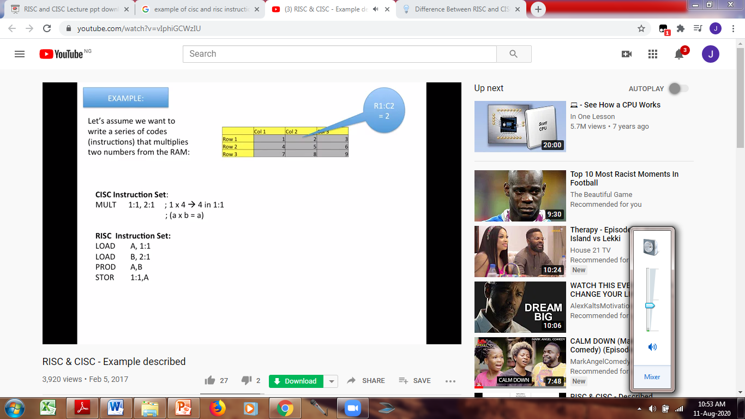
Example: CISC and RISC Instructions

Slide 32
Comparisons between CISC and RISC Processors
Instructions utilize more cycles in CISC than RISC.
• CISC has more complex instructions than RISC.
• CISC typically has fewer instructions than RISC.
• CISC implementations tend to be slower than RISC implementations.
• RISC design is approximately twice as cost-effective as CISC.
• RISC architectures are designed for a good cost/performance, whereas CISC architectures are designed for a good performance on slow memories.

Slide 33
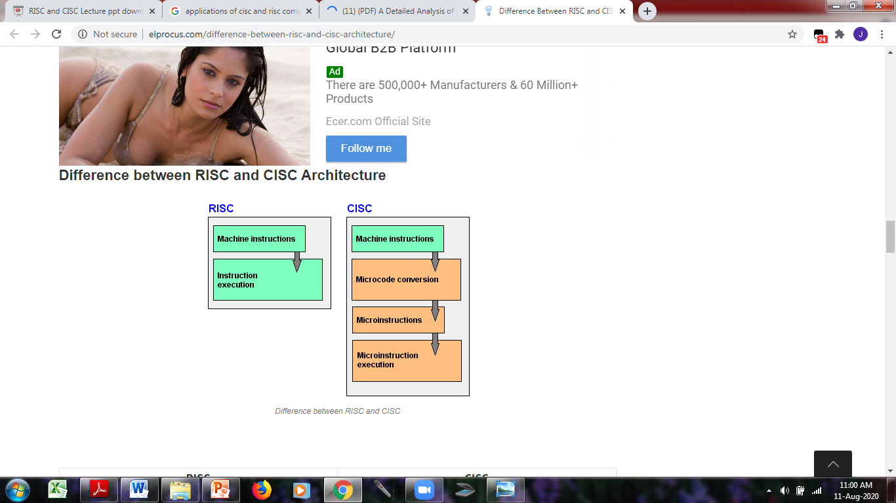
Comparisons between CISC and RISC Processors

Slide 34
cont….
CISC | RISC
Emphasis on hardware | Emphasis on software
Includes multi-clock, complex instructions | Single-clock, reduced instruction only
Memory-to-memory: "LOAD" and "STORE" incorporated in instructions | Register to register: "LOAD" and "STORE" are independent instructions
Slower since instruction can take more than 1 cycle | Faster since instructions usually take 1 instruction cycle
Main objective is less code. | Main objective is speed.

Slide 35
cont….
CISC | RISC
More hardware oriented. | More software oriented since the compiler deals with translations.
Instruction size is mostly varied in size. | Instruction size is always a set size.
Addressing Modes can be complex | Addressing Modes are simple.

Slide 36
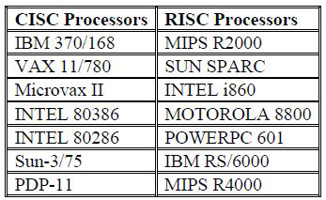
Examples of CISC and RISC Processors

